Slide 1
PMP® Exam Preparation Workshop PMP 250 Session # 5 Project Cost Management
Project Management Professional, (PMP), is a registered mark of the Project Management Institute , Inc.

Slide 2
The contents of this lesson are based on:
A Guide to Project Management Body of Knowledge (PMBOK® Guide) Sixth Edition
Published and Owned by
Project Management Institute, PMI®
PMBOK, PMP, CAPM and PMI are registered trade marks of Project Management Institute, Inc.

Slide 3
LEARNING OBJECTIVES
By the end of this session you will understand:
how Project Cost Management processes relate to the 5 project management process groups in a project phase
the inputs, tools and techniques and outputs for managing Project Cost processes as outlined in PMBOK® Guide which references are applicable

Slide 4
Project Cost Management
Primarily concerned with the cost of the resources needed to complete project activities
Life-cycle costing
Ensuring effective utilization of costs
Predicting & analyzing the financial performance of the product (optional)

Slide 5
Cost Management Processes
7.0
Project Cost
Management
7.1
Plan Cost
Management
7.2
Estimate
Costs
7.3
Determine
Budget
7.4
Control
Costs
Adopted from PMI’s (PMBOK® Guide)

Slide 6
“MUST KNOWS” FOR COST MANAGEMENT
Key Inputs, Tools & Techniques, Outputs For The Four Processes
Types of costs: direct, indirect, fixed and variable costs, and how to differentiate between them
How to recognize and differentiate between: Return on Investment (ROI), Internal Rate of Return (IRR), Net Present Value (NPV), Benefit Cost Ratio (BCR), and Payback Period (PB)
The principle of Opportunity Cost
The characteristics of depreciation
The principle of life-cycle costing
The characteristics of Earned Value Concepts, and the formulas for calculating time and cost variances

Slide 7
TYPES OF COSTS
Direct costs
Costs incurred directly by the project
Examples: cost of cement used in a construction project
Indirect costs
Costs allocated to the project by the organization as a cost of facilitating the project work
Examples: rent, utility costs, insurance
Sunk cost
Costs already expended that can not be recovered
Opportunity costs
Benefits not realized as a result of choosing a particular alternative; The cost of foregoing an opportunity

Slide 8
TYPES OF COSTS
Expense
Cost deducted against income, for tax purposes, in the current year
Examples: labor costs, material costs, fees, charges
Capital Costs
Expenditure to acquire capital assets,
Capital assets are depreciated over time
Examples: purchase cost of equipment & buildings.

Slide 9
ADDITIONAL FINANCIAL MANAGEMENT TECHNIQUES
Depreciation
Return on Investment (ROI)
Payback Analysis
Average Rate of Return (ARR)
Present Value (PV)
Net Present Value / Discounted Cash Flow (NPV/DCF)
Internal Rate of Return (IRR)
Note: PV = Planned Value in Earned Value Management
Notes:
PMP Exam Preparation Workshop - Project Cost Management
9

Slide 10
DEPRECIATION
Method of allocating the cost of an asset over its expected useful life
Four step process:
1. Determine value of asset
2. Estimate expected useful life (# of years)
3. Estimate salvage value (value at the end
of its expected useful life)
4. Allocate the dollar value of the asset
expected to be used up per year
Notes:
PMP Exam Preparation Workshop - Project Cost Management
10

Slide 11
DEPRECIATION METHODS
Four methods of allocating the dollar value of the asset
Straight line (SLD)
Sum of the years digits (SYD)
Double declining balance (DDB)
Units of production
Notes:
PMP Exam Preparation Workshop - Project Cost Management
11

Slide 12
STRAIGHT LINE DEPRECIATION
Easiest method
Depreciation expense written off in a “straight line” or at an even rate
Example:
depreciable value balance = $8000
expected useful life = 5 years
depreciation rate = 1/5 * 100 = 20%
depreciable expense =20%*$8000
= $1,600 per year
Notes:
PMP Exam Preparation Workshop - Project Cost Management
12

Slide 13
SUM OF THE YEARS DIGITS DEPRECIATION
Type of accelerated depreciation
Three step process
1. Sum the digits of the number of years over which
the asset is to be depreciated
2. Establish the depreciation factors
numerator = reverse order of the years
denominator = sum of the years digits (step 1)
3. Calculate each year’s depreciation expense by
multiplying the appropriate depreciation factor
by the depreciable balance
Notes:
PMP Exam Preparation Workshop - Project Cost Management
13

Slide 14
Sum of the Years Digits Example
Depreciable balance = $8000
Expected useful life = 5 years
Sum of the years = (1+2+3+4+5) = 15
Year Depreciation Year’s Depreciable
Factor Depreciation Balance
1 5/15 $2,667 $5,333
2 4/15 $2,133 $3,200
3 3/15 $1,600 $1,600
4 2/15 $1,067 $533
5 1/15 $533 $0
Notes:
PMP Exam Preparation Workshop - Project Cost Management
14

Slide 15
Double Declining Balance Depreciation
A type of accelerated depreciation
Depreciation rate is up to double the straight line depreciation rate
The double declining balance depreciation rate is applied to the declining balance of the cost of the asset rather than to the depreciable balance
Cannot write-off more total depreciation than the amount of the depreciable balance
Notes:
PMP Exam Preparation Workshop - Project Cost Management
15

Slide 16
Double Declining Balance Example
Cost of the asset = $10,000
Salvage Value = $2,000
Depreciable balance = $8,000
Expected useful life = 5 years
Depreciation rate = 2/5 * 100 = 40%
Year Depreciation Declining Year’s
Factor Balance Depreciation
1 40% $10,000 $4,000
2 40 6,000 $2,400
3 40 3,600 $1,440
4 40 2,160 $160
5 40 2,000* 0
* Cannot write-off more than the salvage value (10,000-8,000=2,000)
Notes:
PMP Exam Preparation Workshop - Project Cost Management
16

Slide 17
Units of Production Depreciation
Depreciable balance is allocated according to the number of units the capital asset is expected to produce
Example:
depreciable balance of a truck = $25,000
expected useful life = 5 years
expected total usage = 100,000 miles
cost per mile = $25,000/100,000 = $0.25
assume the same number of miles per
year (20,000)
depreciable expense = 20,000 * $0.25
= $5,000 per year
Notes:
PMP Exam Preparation Workshop - Project Cost Management
17

Slide 18
RETURN ON INVESTMENT (ROI)
Measure of profitability
Also known as return on assets (ROA) or return on total assets (ROTA)
Relates after-tax earnings to the total asset base or investment
Earnings after tax
ROI =
Total investment
Notes:
PMP Exam Preparation Workshop - Project Cost Management
18

Slide 19
PAYBACK ANALYSIS
Calculation of the number of years to pay back the initial investment
In choosing between multiple options or projects, choose the one with the shortest payback period
Simple method but it ignores the time value of money and it ignores expected cash flows beyond the payback period
➔ use net present value and internal rate of
return techniques instead
Notes:
PMP Exam Preparation Workshop - Project Cost Management
19

Slide 20
AVERAGE RATE OF RETURN
Ratio of the average annual profit (either before or after taxes) to the initial or average investment
Example: Investment of $100,000,
Average annual profits of $15,000
Average rate of return = $15,000/$100,000
= 0.15
Simple method but it ignores the time value of money
➔ use net present value and internal rate of
return techniques instead
Notes:
PMP Exam Preparation Workshop - Project Cost Management
20

Slide 21
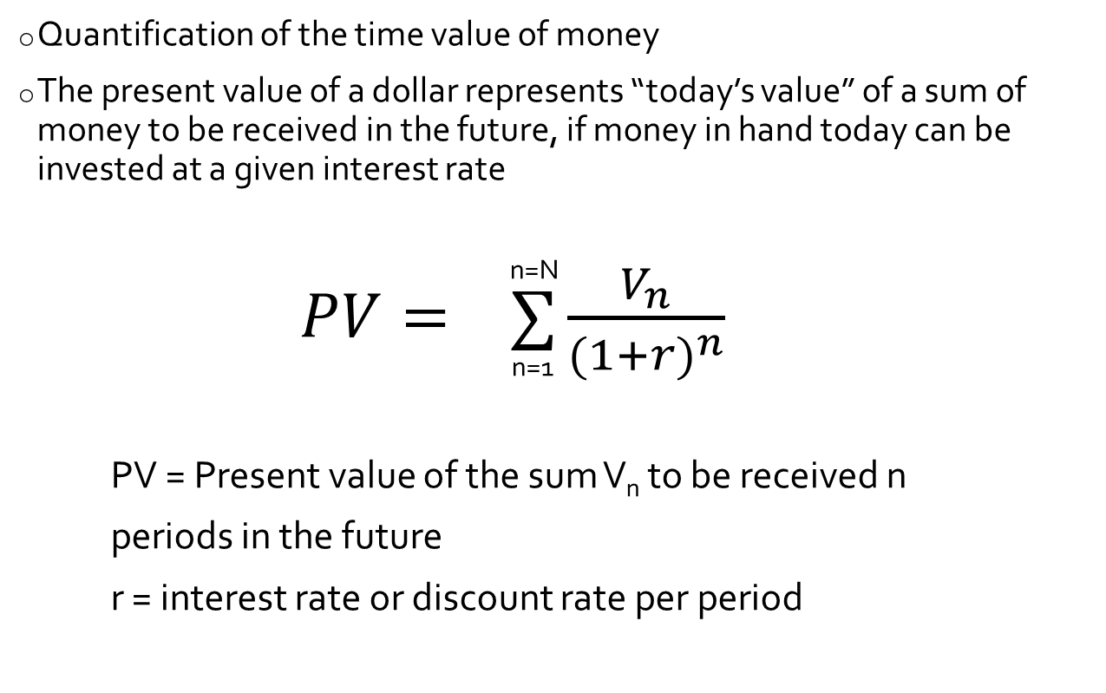
PRESENT VALUE (PV)
Quantification of the time value of money
The present value of a dollar represents “today’s value” of a sum of money to be received in the future, if money in hand today can be invested at a given interest rate
n=N
$PV= ∑\frac{V_{n}}{{(1+r)}^{n}}$
^{n=1}
PV = Present value of the sum V_{n} to be received n
periods in the future
r = interest rate or discount rate per period
Notes:
PMP Exam Preparation Workshop - Project Cost Management
21

Slide 22
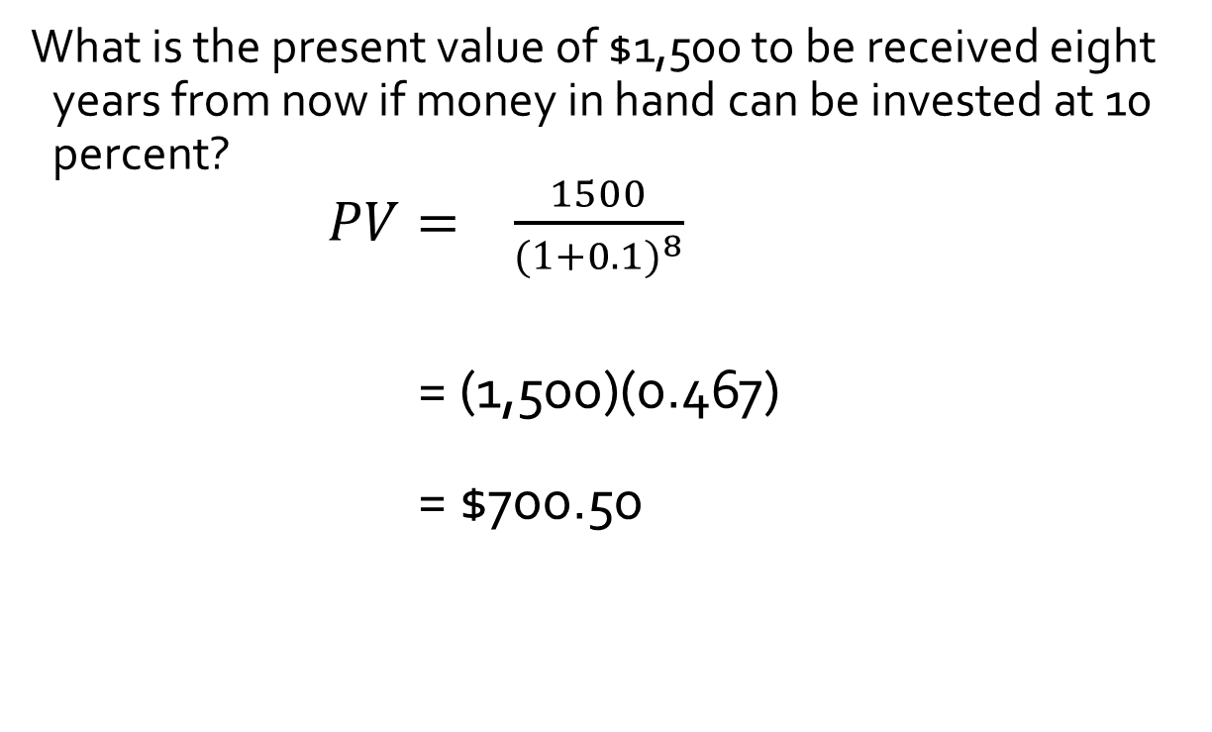
PRESENT VALUE EXAMPLE
What is the present value of $1,500 to be received eight years from now if money in hand can be invested at 10 percent?
$PV= \frac{1500}{{(1+0.1)}^{8}}$
= (1,500)(0.467)
= $700.50
Notes:
PMP Exam Preparation Workshop - Project Cost Management
22

Slide 23
NET PRESENT VALUE (NPV)
Also called Discounted Cash Flow
Net present value is the difference between the present value of the benefits and the present value of the costs
+ve result ➔ acceptable
-ve result ➔ unacceptable
The benefit and cost cash flows are discounted by the required rate of return (also known as the hurdle rate)
Notes:
PMP Exam Preparation Workshop - Project Cost Management
23

Slide 24
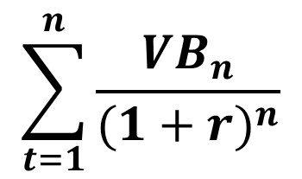
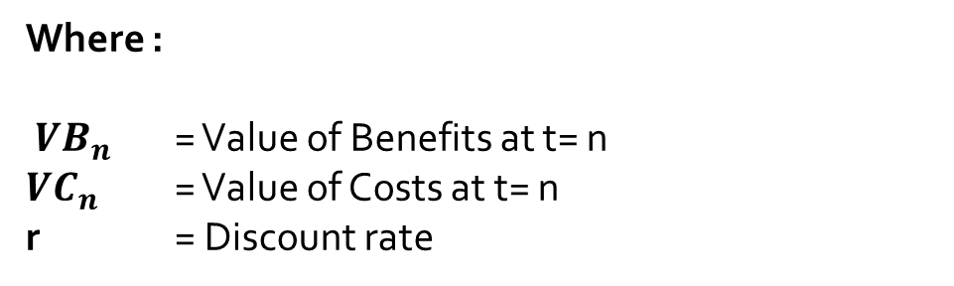
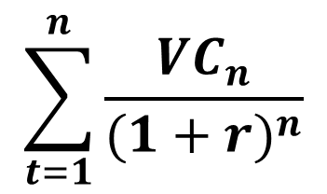
NET PRESENT VALUE (NPV)
$$\sum_{t=1}^{n}{\frac{{VB}_{n}}{{(1+r)}^{n}}}$$
$$\sum_{t=1}^{n}{\frac{{VC}_{n}}{{(1+r)}^{n}}}$$
NPV =
Where :
${ VB}_{n}$ = Value of Benefits at t= n
${VC}_{n}$ = Value of Costs at t= n
r = Discount rate
Notes:
PMP Exam Preparation Workshop - Project Cost Management
24

Slide 25
NET PRESENT VALUE EXAMPLE
Year Benefits Present Value
1 $1,000 $ 909
2 2,000 1,653
3 2,000 1,503
4 5,000 3,415
5 2,000 1,242
Present value of benefits $ 8,722
Less investment $10,000
Net Present Value -$1,278
Notes:
PMP Exam Preparation Workshop - Project Cost Management
25

Slide 26
INTERNAL RATE OF RETURN (IRR)
The discount rate that exactly equates the present value of the expected benefits to the present value of the expected costs
i.e. the discount rate that will drive the
net present value to zero
Value is found by trial and error
IRR greater than cost of capital → acceptable
IRR less than the cost of capital → unacceptable
Notes:
PMP Exam Preparation Workshop - Project Cost Management
26

Slide 27


INTERNAL RATE OF RETURN (IRR)
$$\sum_{t=1}^{n}{\frac{{VB}_{n}}{{(1+r)}^{n}}}$$
$$\sum_{t=1}^{n}{\frac{{VC}_{n}}{{(1+r)}^{n}}}$$
^{VB = Benefits}
^{VC = Costs}
^{r = IRR}
0 =
Notes:
PMP Exam Preparation Workshop - Project Cost Management
27

Slide 28
CONCEPTS FOR PROJECT COST MANAGEMENT
Project Cost is primarily includes the cost of resources needed to complete the project activities.
Project cost management decisions should consider their effect on post-project recurring costs of using, maintaining and supporting the deliverable of the project.
In many organizations analyzing the financial performance of the project product is performed outside life-cycle of the project.
Such analysis may include numerous general financial management techniques such as: return on investment, discounted cash flow (NPV), investment payback, Internal Rate of return, etc.

Slide 29
TRENDS & EMERGING PRACTICES
An extension of EVM practice in Cost Management, includes the concept of Earned Schedule (ES), similar to the concept Earned Value (EV).
ES replaces, the traditional Schedule Variance (SV=EV-PV), with (ES-AT); if the amount of ES>0, then the project is considered to be on schedule; e.g., the project earned more than planned at a given point in time.
The SPI= ES/AT, this indicates the efficiency with which work is being accomplished.
Earned Value concept, also provides for forecasting the project completion date, using ES, AT, and Estimated Duration

Slide 30
TAILORING & AGILE CONSIDERATIONS
Tailoring of Cost Management to projects by an organization, is influenced by the following considerations:
Knowledge Management: availability of financial databases to be used
Estimating and Budgeting: formal or informal cost estimating and budgeting polices, procedures, and guidelines.
Earned Value Management: familiarity with the use of the technique
Use of Agile Approach: Impact of Agile methodology on cost estimating
Governance: existence of formal or informal governance policies, procedures, and guidelines.
Detailed cost calculations are not feasible for projects where scope is not fully defined, and consequently subject to frequent changes. For such projects:
Lightweight methods ae used to generate fast, high-level estimates for project labor and cost, which can be easily adjusted as changes arise
Detailed estimates are generated for short-term planning on “Just-in-Time” basis

Slide 31
7.1 PLAN COST MANAGEMENT
7.0
Project Cost
Management
7.1
Plan Cost
Management
7.2
Estimate
Costs
7.3
Determine
Budget
7.4
Control
Costs
Adopted from PMI’s (PMBOK® Guide)

Slide 32
7.1 PLAN COST MANAGEMENT
Planning how to manage the project costs, the team will take into consideration how costs will be estimated, the accuracy level needed in the Budget, and the measurements that will be used to monitor the budget.
At the start of the project the Project Management Plan will be more of a framework and contain high-level information. However, having it as a an input provides consistent methods of developing subsidiary management plans. A the
project progresses, the project management plan will contain the scope baseline, the schedule baseline, and other more robust and detailed information that can be used to refine the cost management plan.
The project Charter usually contains a high-level budget that usually is used prior to developing a detailed estimate of cost and project budget.

Slide 33
PLAN COST MANAGEMENT – DATA FLOW DIAGRAM
Adopted from PMI’s (PMBOK® Guide)

Slide 34
7.1 PLAN COST MANAGEMENT
.1 Project Charter
.2 Project Mgmt. Plan
Schedule Mgmt. plan
Risk Mgmt. plan
.3 Enterprise Env. Factors
.4 Organizational Process
Assets
.1 Cost Management
Plan
Inputs
.1 Expert Judgment
.2 Data Analysis
.3 Meetings
Tools and Techniques
Outputs
Adopted from PMI’s (PMBOK® Guide)

Slide 35
7.1.1 PLAN COST MANAGEMENT:INPUTS
.1 Project Charter
Provides preapproved financial resources from which the budget is developed
Defines the project approval requirements that influences cost management
.2 Project Management Plan
The information provided mainly by the following components of the project management plan, is used to develop the Cost Management Plan:
Schedule Management Plan: provides processes and controls that will impact cost estimation and management
Risk Management Plan: provides processes and controls that will impact cost estimation and management

Slide 36
7.1.1 PLAN COST MANAGEMENT:INPUTS
.3 Enterprise Environmental Factors:
Organizational Culture • Market Conditions
Currency exchange rates • Published Commercial
PMIS information
Productivity differences in different parts of the world
.4 Organizational Process Assets
Financial Control Procedures • Historical Information, Lessons learned repository
Financial Databases • Cost estimating & budgeting policies

Slide 37
7.1.2 PLAN COST MANAGEMENT: TOOLS & TECHNIQUES
.1 Expert Judgment
Provides valuable insight about the environment and information from
Previous similar projects
Industry, discipline, and application area
Cost estimating and budgeting
EVM
.2 Data Analysis
Alternative analysis for choosing between various strategic options to fund the project
Analyzing make-buy-rent-lease considerations
.3 Meetings
Planning sessions among appropriate stakeholders to develop the
cost management plan.

Slide 38
7.1.3 PLAN COST MANAGEMENT: OUTPUT
.1 Cost Management Plan
Describes the processes and associated tools for planning, structuring and
controlling project costs. The plan establishes for instance:
Units of measure, units of measurement for each of the resources.
Level of Precision, the degree of rounding up of estimates
Level of accuracy, acceptable range in determining estimates; (±10%)
Organizational procedure links: the WBS component used for project cost
accounting is called Control Account. Each control account is assigned a unique code that links directly to the organization’s accounting system
Control Thresholds: an agreed-upon amount of variation to be allowed before action needs to be taken.
Rules of performance measurements: preset EVM rules of performance measurements; for instance:
Define points in the WBS at which measurement will be performed
Establish EVM techniques
Specify tracking methodologies and EVM computations for EAC
Reporting formats
Additional details such as funding choices, accounting methods for currency exchange rate fluctuations, cost recording procedure.

Slide 39
7.2 ESTIMATE COSTS
7.0
Project Cost
Management
7.1
Plan Cost
Management
7.2
Estimate
Costs
7.3
Determine
Budget
7.4
Control
Costs
Adopted from PMI’s (PMBOK® Guide)

Slide 40
7.2 ESTIMATE COSTS
Estimates are predictions, not facts. As the scope of the project is defined in more detail, the cost estimates are more accurate and the range of estimates narrows. In projects with lots of R&D and high complexity, it is not uncommon for initial estimates to have a range of ± 50%. By the time the details are defined, the schedule is baselined, and the project risks are accounted for, the range may be closer to ±10%.
Cost estimating is one of the most sensitive topics in project management. Customers and sponsors want to know how much will the project cost as soon as possible. Yet getting reliable estimates early in the project is often not possible. This often leads to putting out inaccurate estimates and then being held accountable for meeting the estimate.
The Cost Management Plan must include a section on estimating guidelines. Define ranges, and accuracy of estimates for each phase of the life-cycle. This will help set the stakeholder expectations of estimate accuracy as the project progresses.
Adopted from PMI’s (PMBOK® Guide)

Slide 41
7.5 ESTIMATE COSTS – DATA FLOW DIAGRAM
Adopted from PMI’s (PMBOK® Guide)

Slide 42
7.2 ESTIMATE COSTS
.1 Project Mgmt. Plan
Cost Mgmt. plan
Quality Mgmt. Plan
Scope Baseline
2 Project Documents
Lessons learned Reg.
Project Schedule
Resources Reqm’ts.
Risk Register
3 Ent. Env. Factors
4 Org. Process Assets
Inputs
1 Expert Judgment
2 Analogous Estimating
3 Parametric Estimating
4 Bottom-up Estimating
5 Three-point estimates
6 Data Analysis
Alternative Analysis
Reserve Analysis
Cost of Quality
7 PMIS
8 Decision Making
Voting
Tools & Techniques
1 Cost Estimates
2 Basis of Estimates
3 Project Document
Updates
Assumption log
Lessons learned
Risk Register
Outputs
Adopted from PMI’s (PMBOK® Guide)

Slide 43
7.2.1 ESTIMATE COSTS: INPUTS
.1 Project Management Plan
Cost Management Plan Specifies the method to be used and the level of accuracy to estimate project costs.
Quality Management Plan Specifies the activities and resources required to achieve the quality objectives set for the project
Scope Baseline All three components of the baseline; i.e., Scope Statement, WBS and WBS Dictionary are used to ensure that cost estimates take into consideration the complete scope of the project
.2 Project Documents
Lessons Learned Register provides cost information from previous projects
Project Schedule
Used to provide input about activity duration, type and quantity or resources, materials, rates, etc. needed for estimating project costs.

Slide 44
7.2.1 ESTIMATE COSTS: INPUTS
.2 Project Documents (cont’d)
Resource Requirements, identifies the type and quantity of resources required for each activity
Risk Register provides detailed information about project risks that require cost estimates to respond to
.3 Enterprise Environmental Factors
Market Conditions describes products, services and results available in the market, their sources, and regional/global supply and demand conditions, that influence resource costs.
Published commercial information; databases that track skills and labor costs. Provides standard material costs for material and equipment
Exchange Rates and inflation, information needed for long-term international projects
.4 Organizational Process Assets
Cost estimation policies, templates, historical data and lessons learned.

Slide 45
7.2.2 ESTIMATE COSTS: TOOLS & TECHNIQUES
.1 Expert Judgment
Tacit knowledge of experts is sought for cost estimating, from previous similar projects, industry and cost estimating methods.
.2 Analogous Estimating
Also called “top-down”
Using the actual cost of previous similar projects
Used when limited amount of information available
Compared values and attributes may include scope, budget, duration.
Less costly, less accurate
.3 Parametric Estimating
Project characteristics (parameters) in a mathematical model/database
Example: cost per square foot
Accuracy depends on the historical information used to develop the model and the ability to easily quantify the parameters

Slide 46
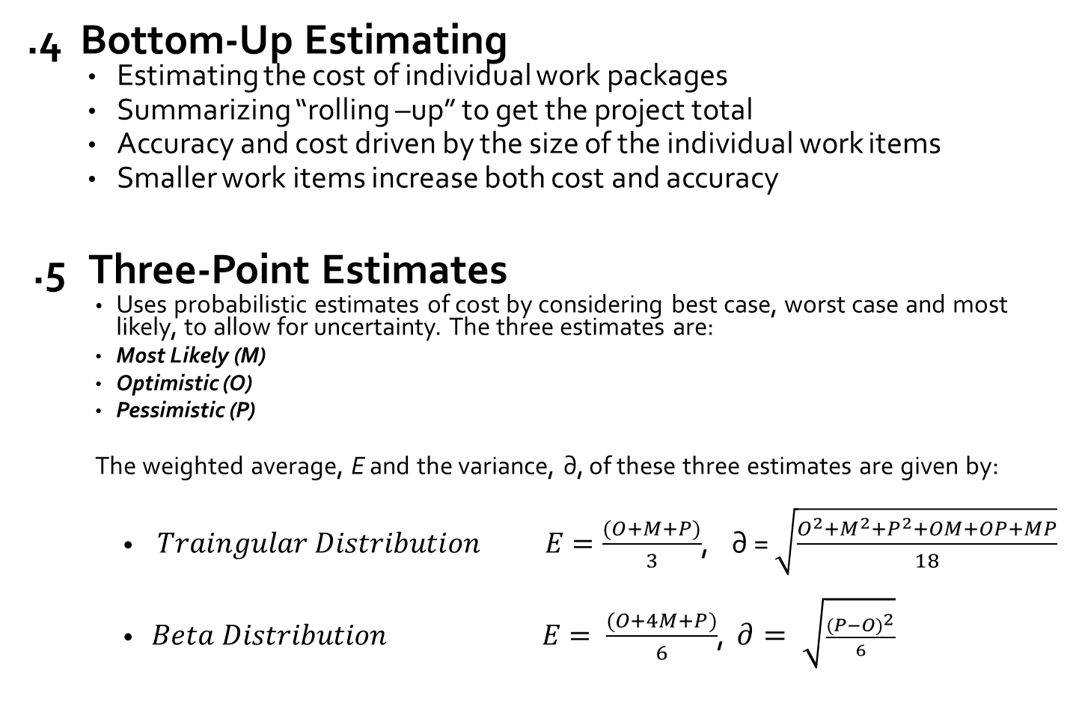
7.2.2 ESTIMATE COSTS: TOOLS & TECHNIQUES
.4 Bottom-Up Estimating
Estimating the cost of individual work packages
Summarizing “rolling –up” to get the project total
Accuracy and cost driven by the size of the individual work items
Smaller work items increase both cost and accuracy
.5 Three-Point Estimates
Uses probabilistic estimates of cost by considering best case, worst case and most likely, to allow for uncertainty. The three estimates are:
Most Likely (M)
Optimistic (O)
Pessimistic (P)
The weighted average, E and the variance, ∂, of these three estimates are given by:
$Traingular Distribution E=\frac{(O+M+P)}{3}$, ∂ = $\sqrt{\frac{O^{2}+M^{2}+P^{2}+OM+OP+MP}{18}}$
$Beta Distribution E= \frac{(O+4M+P)}{6}$, $∂= \sqrt{\frac{{(P−O)}^{2}}{6}}$

Slide 47
7.2.2 ESTIMATE COSTS: TOOLS & TECHNIQUES
.6 Data Analysis
Alternative Analysis, used to evaluate identified options, in order to select the most suitable option to execute and perform the work of the project.
Reserve Analysis, Contingency reserves are allocated for identified risks in cost estimate; Part of the cost baseline; Assigned to a work package with zero time. As more precise information becomes available, the contingency reserve may be used, reduced or eliminated.
Cost of Quality A cost allocation factored in the project estimates , to cover the costs of conformance and non-conformance to project quality standards
.7 Project Management Software
Project Management Cost estimating software used to help establish project activity costs.
Spreadsheets, simulation, statistical tools
.8 Decision Making Team members vote on the approach to be used.

Slide 48
7.2.3 ESTIMATE COSTS: OUTPUTS
.1 Cost Estimates
Estimates of the cost of the resources to complete the activities of the project, as well as contingency amounts, management reserve, plus the cost of equipment, services, facilities, IT, financing, allowances for inflation and exchange rate changes as applicable.
Can be refined during the course of the project
.2 Basis of Estimates
Additional detailed documentation supporting the cost estimates, to provide a clear and complete explanation of the assumptions made, constraints considered and how the estimates were derived., indication of the range of possible estimates, indication of the confidence level of the estimates.
.3 Project Document Updates
Updates to all relevant documents, particularly the Risk Register, to show contingency allocations, assumption log and lessons learned register.

Slide 49
ACCURACY OF ESTIMATES
Rough Order of Magnitude (ROM)
(also known as Conceptual or Ballpark or Preliminary)
-25% to +75%
Budget
(also known as Control or Design Development or Release)
-10% to +25%
Definitive
-5% to +10%

Slide 50
SITUATIONAL QUESTIONS & REAL WORLD APPLICATION
The consequences of deficient cost estimating could be very serious; e.g.,
the project could be terminated due to funding shortfall
the project could be terminated if subsequent cost analysis showed that it was undertaken at a loss or under unacceptable profit margin.
The project could face major delays because of unavailability of or delays in securing the necessary funding to complete the project on time.

Slide 51
7.3 DETERMINE BUDGET
7.0
Project Cost
Management
7.1
Plan Cost
Management
7.2
Estimate
Costs
7.3
Determine
Budget
7.4
Control
Costs
Adopted from PMI’s (PMBOK® Guide)

Slide 52
7.3 DETERMINE BUDGET
The primary activity is aggregating the cost estimates for the activities and work packages to create an authorized cost baseline for the project.
The cost baseline should be created in a time-based format, to help track and determine the cost needs of the project at any point in time throughout its life cycle.
The budget establishes the basis for measuring, monitoring and controlling project costs.
The budget constitutes the authorized and distributed funds to execute the project.
Adopted from PMI’s (PMBOK® Guide)

Slide 53
7.3 DETERMINE BUDGET – DATA FLOW DIAGRAM
Adopted from PMI’s (PMBOK® Guide)

Slide 54
7.3 DETERMINE BUDGET
1 Project Mgmt. plan
Cost management plan
Resource Mgmt. Plan
Scope baseline
2 Project Documents
Cost estimate
Basis of estimates
Project schedule
Risk register
3 Business Documents
Business Case
Benefits Mgmt. Plan
4 Agreements
5 Enterprise Env. factors
6 Org Process Assets
Inputs
Tools and
Techniques
1 Expert judgment
2 Cost aggregation
3 Data Analysis
Reserve analysis
4 Historic Info review
5 Funding limit
reconciliation
6 Financing
1 Cost baseline
2 Project funding
requirements
3 Project document
updates
Cost Estimates
Project Schedule
Risk Register
Outputs
Adopted from PMI’s (PMBOK® Guide)

Slide 55
7.3.1 DETERMINE BUDGET:INPUTS
.1 Project Management Plan
Cost Management Plan Describes how the project budget will be established and controlled
Resource Management Plan provides information on rates, foreseen costs and cost estimates
Scope Baseline
Project Scope Statement: Indicates any funding limitations per period
WBS: Provides information about relationships among project deliverables
WBS Dictionary: provides description of work in each work package.
.2 Project Documents
Basis of Estimates Provides supporting details e.g., assumptions, inclusions, exclusions, etc.
Cost Estimates Provide cost estimates of resources to complete the project activities
Project Schedule Allows viewing the project timeline to determine the amount and the time of the costs to be budgeted.
.3 Risk Register
Reviewed to aggregate the costs of risk responses.

Slide 56
7.3.1 DETERMINE BUDGET:INPUTS
.3 Business Documents
Business Case Identifies critical success factors for the project
Benefits Management Plan identifies target benefits, their timeframe, and the metrics.
.4 Agreements
Provide cost and timing information about procured goods and services to be included in the budget
.5 Enterprise Environmental Factors
Financial factors that can influence cost estimates such as exchange rates
.6 Organizational Process Assets
Influence budgeting through existing organizational policies, procedures, guidelines, tools, and reporting methods

Slide 57
7.3.2 DETERMINE BUDGET:TOOLS & TECHNIQUES
.1 Expert Judgment
Tacit knowledge appropriate for determining the budget. Such knowledge as information from previous similar projects, industry, discipline, or application area, financial principles, and funding requirements
.2 Cost Aggregation
To roll up the project costs starting with activity costs, to work package costs, and finally to the project cost

Slide 58
7.3.2 DETERMINE BUDGET:TOOLS & TECHNIQUES
.3 Data Analysis
Reserve Analysis
To establish contingency funds for adverse events that may impact the project. These funds are called Contingency Reserves
Management Reserves: Budgeted reserves for unplanned but potentially required changes to project scope and cost as a result of “unknown unknowns”. Approval required before spending Management Reserves.
Management Reserves are not part of the cost baseline, but are included in the budget.
Not distributed as part of Cost Baseline, therefore not part of Earned Value Calculations.
.4 Historical Information
Assists in developing parametric or analogous estimates. Reliability of historical information depends on
Accuracy of the model used
Quantifiable Parameters
Scalability of the models used.

Slide 59
7.3.2 DETERMINE BUDGET:TOOLS & TECHNIQUES
.5 Funding Limit Reconciliation
Reconciliation of spending with funding limits set by customer or performing organization for disbursement of funds.
May require adjusting work schedules to regulate expenditures, by placing imposed date constraints on some work packages.
Re-scheduling can impact resource allocation.
If funds were used as a limiting resource in the schedule development process, then the process is repeated using the new imposed date constraints, to produce the cost baseline.
6 Financing
If external funding is needed for long-term infrastructural or industrial or public service projects.

Slide 60
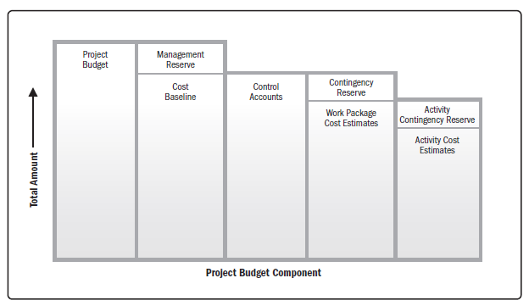
7.3.3 DETERMINE BUDGET: OUTPUTS
.1 Cost Baseline
Approved version of the time-phased project budget, excluding any management reserves.
Provides planned cumulative total project costs (S-curve)
The components of the project budget are shown in the figure below
Adopted from PMI’s (PMBOK® Guide 6th Edition Fig 7-8 Page 255)

Slide 61
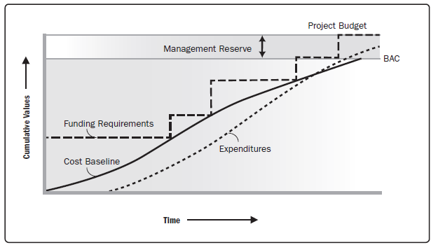
7.3.3 DETERMINE BUDGET: OUTPUTS
.2 Project Funding Requirements
Total and periodic fund requirements, derived from the cost baseline.
Can be established to exceed some margins.
Funding is a step function. Not continuous
The cost baseline and the cash flow lines would increase when a portion of the management reserve is authorized and spent.
Any gap at the end of the project, between funds allocated and the cost baseline and cash flow amounts, shows the amount of management reserve that was not used.
Budget at completion = budget base line: usually as “S” curve.
If over budget base line, the extra money is from Management reserver
Adopted from PMI’s (PMBOK® Guide 6th Edition Fig 7-9 Page 255)

Slide 62
7.3.3 DETERMINE BUDGET: OUTPUTS
.3 Project Documents Updates
As the process of determining the budget is performed several documents may require updating. These include but are not limited to:
cost estimates
Project Schedule
Risk register

Slide 63

If the Project Management Team do not adequately complete the process of determining a budget, the project could encounter a multitude of problems. By failing to estimate and fund required work, the project could face budget overruns. If an approved budget is not in place, the project could suffer delays due to equipment and material required for the project being not acquired.

Slide 64
7.4 CONTROL COSTS
7.0
Project Cost
Management
7.1
Plan Cost
Management
7.2
Estimate
Costs
7.3
Determine
Budget
7.4
Control
Costs
Adopted from PMI’s (PMBOK® Guide)

Slide 65
7.3 CONTROL COSTS
Updating the budget requires knowledge of the actual costs. Any increase in authorized budget can only be approved through Perform Integrated Change Control. Main focus of control costs processes involves Earned Value Management. The process involves:
Influencing the factors that create changes to the baseline
Ensuring all change requests are acted upon in a timely manner
Managing actual changes when they occur
Ensuring expenditures do not exceed authorized funding limits
Monitoring cost performance manage variances
Monitoring work performance against expenditure
Preventing unapproved changes from being included or reported
Informing appropriate stakeholders of all approved cost changes
Bringing expected cost overruns within acceptable limits

Slide 66
7.4 CONTROL COSTS – DATA FLOW DIAGRAM

Slide 67
7.4 CONTROL COSTS
Inputs
Tools and
Techniques
1 Project Mgmt. Plan
Cost Mgmt. Plan
Cost Baseline
Performance
Measurement
Baseline
2 Project Documents
Lessons Learned Reg.
3 Funding Req.
4.Work Performance
Data
5 Organizational Process
Assets
1 Expert Judgement
2 Data Analysis
Earned Value Analysis
Variance Analysis
Trend Analysis
Reserve Analysis
2 Forecasting
3 To-Complete
Performance Index
4 Performance Reviews
5 PMIS
1 Work Performance
Information
2 Cost Forecasts
3 Change Requests
4 Project Mgmt Plan
Updates
Cost Mgmt. Plan
Cost Baseline
Performance
Measurement Base
5 Project Document
Updates
Assumption log
Basis of Estimates
Cost Estimates
Lesson Learned Reg.
Risk Register
Outputs
Adopted from PMI’s (PMBOK® Guide)

Slide 68
7.4.1 CONTROL COSTS: INPUTS
.1 Project Management Plan
Serves as the baseline for the work being done and provides the following information to help control costs:
Cost Baseline
Cost Management Plan
Performance Measurement Baseline
.2 Project Documents
Lessons learned register, may provide information relevant to later phases of the project
.3 Project Funding Requirements
Provides information regarding when and how much money is needed, as they relate to cost control
.4 Work Performance Data
Provides information regarding percentage of work completed
.5 Organizational Process Assets
Influences cost control by providing existing cost control related policies, procedures, guidelines, tools, monitoring and reporting reports.

Slide 69
7.4.2 CONTROL COSTS: TOOLS & TECHNIQUES
.1 Expert Judgement
Expert judgement needed for: Variance analysis, Earned Value Analysis, forecasting and financial analysis
.2 Data Analysis
Earned Value Analysis (EVA) Is a performance measurement method, that integrates, scope, cost and schedule and helps the project team assess project progress.
EVA develops and monitors three key dimensions for each work package and control account:
Actual Cost (AC) – Actual Cost of Work Performed (ACWP)
Earned Value (EV) - Budgeted Cost of Work Performed (BCWP)
Planned Value (PV) – Budgeted Cost of Work Scheduled (BCWS)
Cumulative PV = Budget at Completion (BAC)

Slide 70
VARIANCE ANALYSIS
Schedule Variance (SV)
SV = EV - PV
Schedule Performance Index (SPI)
SPI = EV / PV
Cost Variance (CV)
CV = EV - AC
Cost Performance Index (CPI)
CPI = EV / AC

Slide 71
EVA Example
Consider a 4-day task worth $100 or $25/day. On the end of 3rd day, the resource reported 50% completion only
Budget at Completion (BAC) = $100
Earned Value (EV) = $50
Actual Spent (AC) = $75
Planned Value (PV) = $75
Cost Variance (CV) = EV minus AC = -$25 (Over Budget)
Schedule Variance (SV) = EV minus PV = -$25 (Late or Behind Schedule)
Cost Performance Index (CPI) = EV/AC = 0.66 (Productivity Rate of 66%)
Schedule Performance Index (SPI) = EV/PV = 0.66 (Progress Rate of 66%)
Burn Rate or Budget Utilization = AC/EV = 1.5
EVA Interpretations:
A positive CV indicates that you are under budget on a particular task and hence can use a portion of task budget for some other task
A positive SV indicates ahead of schedule and hence can use some of the task resources for a task which is late
A negative CV or SV means there are problems that require corrective actions
Performance Ratios, CPI and SPI can be equal to 1, greater than 1 or less than 1. A value greater than 1, indicates we are ahead of schedule or under budget. A values of less than 1, indicates we are behind or over budget

Slide 72
Forecasting using EVA
Forecasting Estimate at Completion (EAC)
EAC at the current CPI i.e. the remaining work is assumed to be completed at the same rate as current CPI
EAC = BAC / CPI ($151)
EAC at the budgeted rate i.e. the remaining work will be completed at the original budgeted rate irrespective of what has happened so far.
EAC = AC + BAC – EV ($125)
EAC considering both CPI and SPI
EAC = AC + [(BAC-EV) / (CPI * SPI)] ($189)
EAC = AC + Revised bottom-up ETC (Estimate to Complete remaining work of project)
ETC (Estimate to Complete project) = EAC - AC OR Re-estimate remaining work from bottom up
VAC (Variance at Completion of project) = BAC minus EAC
To Complete Performance Index (TCPI) is the calculated projection of cost performance index that must be achieved on the remaining work in order to achieve BAC or EAC
TCPI = Work Remaining / Funds Remaining
TCPI based on BAC = (BAC – EV) / (BAC – AC)
(2.0 i.e. productivity should be 200%)
TCPI based on EAC = (BAC – EV) / (EAC – AC)
(1.0 i.e. productivity should be 100%) where EAC is $125

Slide 73
EARNED VALUE ANALYSIS
Adopted from PMI’s (PMBOK® Guide 6th Edition Fig. 7-12 page 264)

Slide 74
7.4.3 COST CONTROL: OUTPUTS
.1 Work Performance Measurements
EVM results are documented and communicated for each WBS component; i.e., CV, SV, EAC, VAC, and TCPI
.2 Cost Forecasts
Revised EAC are calculated, documented and communicated.
.3 Change Requests
As a result of project Performance analysis, corrective or preventive actions may be requested for approval.
.4 Project Management Plan Updates
The plan is updated to reflect approved budget adjustments. The update is applicable to the cost management plan, Cost Baseline, Performance Measurement Baseline
.5 Project Document Updates
Updates include: Assumption Log, Basis of Estimates, Cost Estimates, Lessons Learned Registry and Risk Register.

Slide 75
Changes to the plan are inevitable on a project of any size. The lack of Control Cost process could slow down project completion because time is spent trying to figure out what to do to eliminate any cost overruns or account for under-runs.

Slide 76
Exercise - Earned Value Problem
The project: Install five software packages in 5 weeks for a total consulting fee of $5,000.
Status: After two weeks only 1 install has been done for a cost of $1,500.
Questions:
Determine PV, AC, EV
Calculate SV, CV, SPI, CPI
Also calculate EAC, assuming current productivity
Forecast project Completion time

Slide 77
Exercise Solution
Budget at Completion BAC $5,000
Actual Cost AC $1,500
Earned Value EV $1,000
Planned Value PV $2,000
Schedule Variance SV EV – PV
= -$1,000
Cost Variance CV EV – AC = -$500

Slide 78
Exercise Solution
Schedule Performance Index SPI = EV / PV
= 1000/2000
= 0.5
Cost Performance Index CPI= EV / AC
= 1000/1500
= 0.6667
Estimate at Completion EAC= BAC / CPI
= 5000/0.6667
= $7,500
Forecast Completion Time 10 Weeks

Slide 79
Appendix

Slide 80
Example
For each task
Calculate Cost Variance (CV)
Calculate Schedule Variance (SV)
For the project
Calculate Cost Variance (CV)
Calculate Schedule Variance (SV)
Calculate Estimate At Completion (EAC)

Slide 81
Example
Project Plan
1 2 3
BAC % PV EV AC
A
100
200
600
200
300
1400
100
50
80
50
10
100
200
600
100
0
1000
100
100
480
100
30
810
130
100
580
100
50
960
B
C
D
E
Time
Now

Slide 82
Example
Total Project
Project Plan
1 2 3
CV SV
CV =
CPI =
SV =
SPI =
EAC =
-30 0
A
B
0 -100
C
-100 -120
0 0
D
E
-20 30
Time
Now

Slide 83
Example
Project Plan
1 2 3
BAC % PV EV AC CV SV
100 100 100 100 130 -30 0
200 50 200 100 100 0 -100
600 80 600 480 580 -100 -120
200 50 100 100 100 0 0
300 10 0 30 50 -20 30
1400 1000 810 960 -150 -190
A
B
C
D
E
Time
Now
CPI = 810/960 = 0.84
SPI = 810/1000 = 0.81
EAC = 1400/0.84 = 1667

Slide 84
FORECASTING
Estimates for future project performance based on information presently available.
As the project progresses Estimate At Completion (EAC) may differ from Budget At Completion (BAC)
EAC is based on actual costs incurred for work completed, plus an Estimate To Complete (ETC) the remaining work.
ETC can be calculated based on any of the following three assumptions:
EAC forecast for ETC work performed at the budgeted rate: EAC = AC + (BAC-EV)
EAC forecast for ETC work performed at the present CPI: EAC = BAC/(cumulative CPI)
EAC forecast for ETC considering both SPI & CPI: EAC = AC +[(BAC-EV)/(CPI x SPI)]
Each of the tree approaches can be correct for any given project and will provide an “early warning” signal if the EAC forecasts are not within acceptable range.

Slide 85
Forecasting (cont’d)
Earned value analysis is performed periodically to track project performance against the approved baselines for time, cost and scope.
As the project progresses, the team needs also forecast an Estimate AT Completion (EAC) cost to determine if the project can be completed within the approved budget (BAC).
Forecasting the EAC is based on current work performance data and other information available at the time of the forecast.
EACs are calculated by adding the actual costs incurred for the work completed to an estimate of the cost for the work remaining to complete the project; Estimate To Complete (ETC) EAC = AC + ETC
ETC requires the team to perform a new bottom-up estimate to complete the remaining project work. Estimated values of ETC are compared with a range of calculated values for ETC, representing various risk scenarios. The three more common methods of forecasting EAC based on different scenarios considered for ETC are:
EAC forecast for ETC work performed at the budgeted rate
EAC forecast for ETC work performed at the present CPI
EAC forecast for ETC work considering both SPI and CPI

Slide 86
FORECASTING (cont’d)
1. EAC forecast for ETC performed at the budgeted rate.
This scenario assumes that future work to complete the project, ETC, will be accomplished at the budgeted rate; i.e., the same as the rate calculated for the performance to date (whether favorable or unfavorable). When actual performance to date is unfavorable, the assumption that future performance will improve, should be accepted only when supported by project risk analysis; i.e., the improved rate will not be result into additional project risks.
EAC = AC + (BAC – EV)
ETC
Actual Cost of
Completed Work

Slide 87
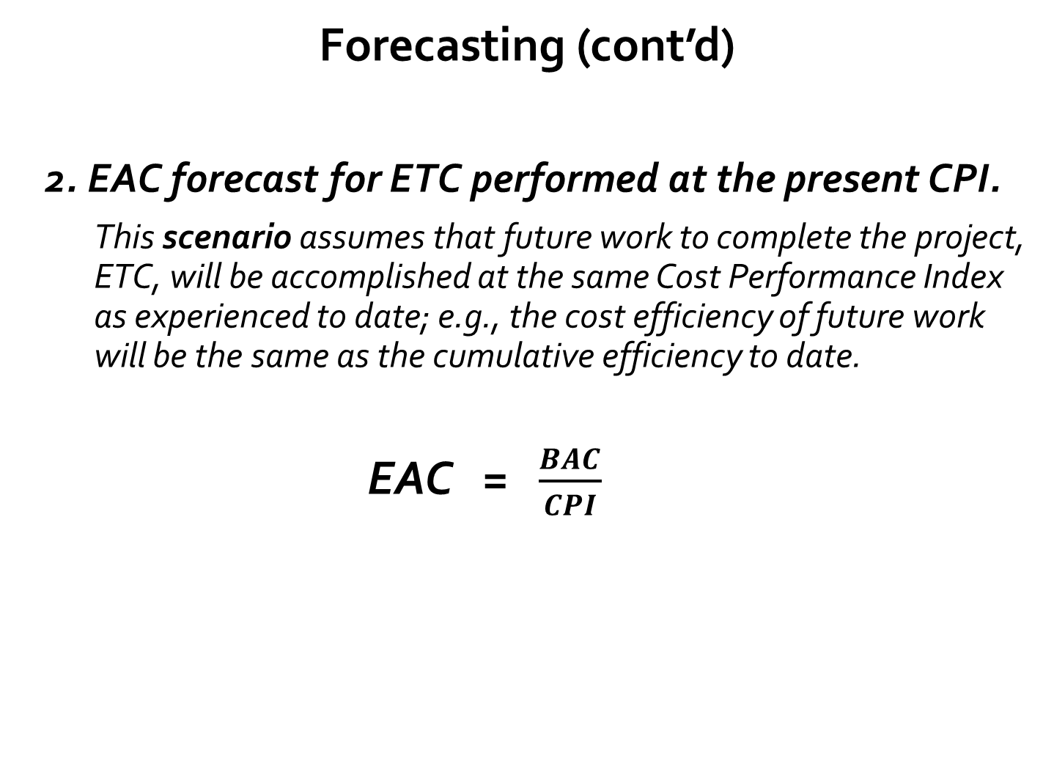
Forecasting (cont’d)
2. EAC forecast for ETC performed at the present CPI.
This scenario assumes that future work to complete the project, ETC, will be accomplished at the same Cost Performance Index as experienced to date; e.g., the cost efficiency of future work will be the same as the cumulative efficiency to date.
EAC = $\frac{BAC}{CPI}$

Slide 88
Forecasting (cont’d)
3. EAC forecast for ETC work considering both SPI and CPI factors.
This scenario assumes that future work to complete the project, ETC, will be at an efficiency rate that considers both the cost and the schedule performance indices. This method is most useful when the project schedule is a factor influencing the ETC effort.
EAC = AC + [(BAC – EV)/(CPI x SPI)]
ETC
Actual Cost of
Completed Work

Slide 89
RESERVE ANALYSIS
Throughout the cost control process, both contingency and management reserves are monitored to determine if these are still needed; otherwise they could be released to other projects, or, if additional reserves are needed due to new identified risks, more reserves would be requested.
when not used, the reserves could be removed from the budget or taken as profits.

Slide 90
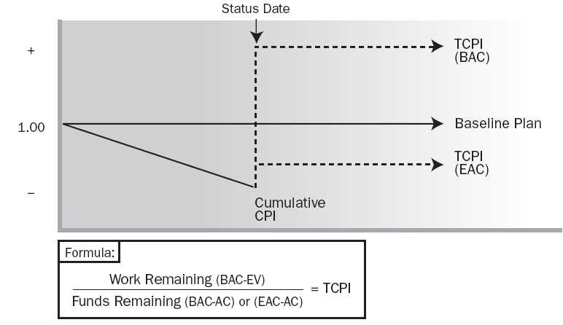
7.4.2 CONTROL COSTS: TOOLS & TECHNIQUES
.3 To-Complete Performance Index (TCPI)
Used to calculate what spending efficiency is needed for the remaining work to complete the project either:
(i) on its original budget (BAC) or, if BAC is no longer feasible,
(ii) a subsequently approved estimate at completion (EAC).
TCPI > 1 to complete project
at BAC value
TCPI > cumulative CPI to date
to complete project at approved EAC value
Adopted from PMI’s PMBOK® Guide 6th Edition Fig 7-13, Page 268

